Slide 1

An Introduction to …
Pleadings!
or
Real Civ Pro!

Slide 2
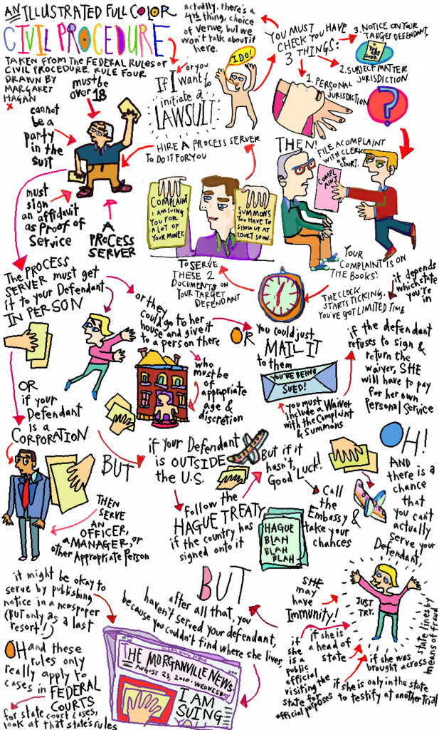
Where are we in that alternate universe called
Civil Procedure?

Slide 3
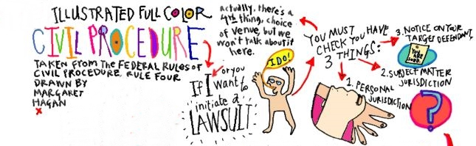



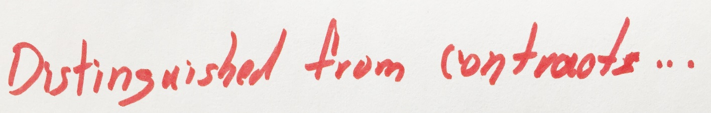

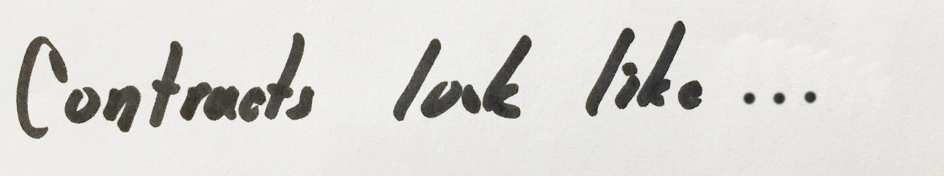


Slide 4
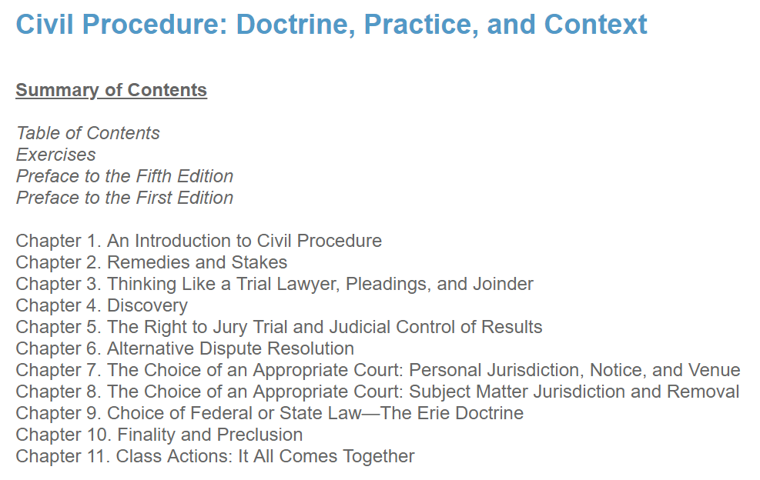
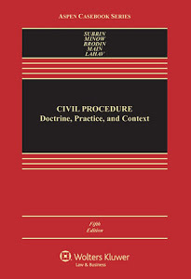
OK, where are we, really, in this course?

Slide 5
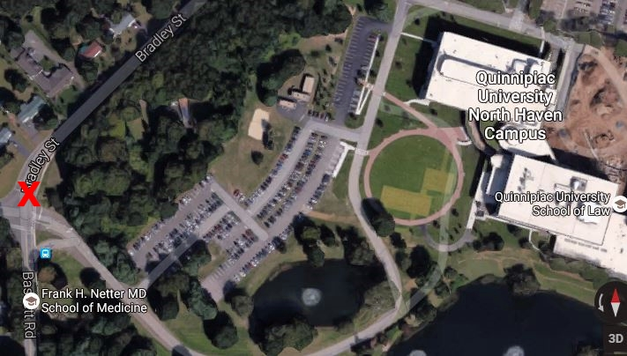
So far …
Joe/Joette Class v. JT
  Short overview of the course and how a civil case proceeds through the federal court system
Introductory materials in our casebook
  2 central points
    US v Hall, 472 F.2d 261 (5th Cir., 1972)
      Whether non-party could be held in contempt for violating an injunction
      Conflict between FRCP (65) and court’s inherent authority
    Goldberg v. Kelly, 397 U.S. 254 (1970)
      14th Amend. Due Process rights: 1) private interest, 2) gov’t interest, 3) risk of error vs. value of safeguard
      Hamdi v. Rumsfeld, 542 U.S. 507 (2004): 5th Amend. context

Slide 6
Other basic concepts during introduction
  Appealable orders
  Standard of review on appeal
  Burden of proof at trial (preponderance, beyond a reasonable doubt, clear and convincing evidence)

Slide 7
Remedies
Provisional Remedies
  FRCP 65
    Ex parte TRO – 14 days
    Preliminary injunction – until trial
    Permanent injunction
  Winter v. Natural Resources Defense Council, 555 U.S. 7 (2008)
    4 part PI test
      Likelihood of success on merits
      irreparable injury
      Balance of equities tips in favor of pI
      PI in public interest
    Deference to executive branch

Slide 8
Final Remedies
Final injunction
  irreparable injury
  remedies available at law, such as monetary damages, are inadequate to compensate for that injury;
  balance of hardships between the plaintiff and defendant, a remedy in equity is warranted;
  Public interest would not be disserved by a permanent injunction
Walgreen Co. v. Sara Creek Property Co., 966 F. 2d 273 (7th Cir. 1992)
  Judge Posner would eliminate irreparable injury requirement when considering permanent injunction

Slide 9

Damages cannot be speculative
Costs (28 USC § 1920) & FRCP 68
“Financing litigation”

Slide 10
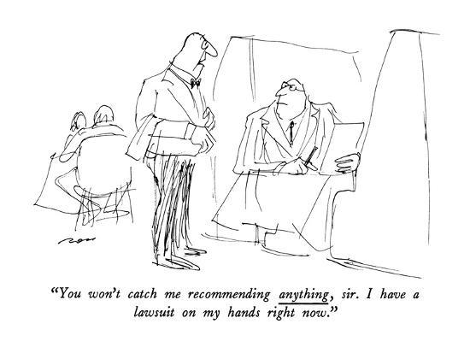
And now …
We are ready to file a lawsuit

Slide 11
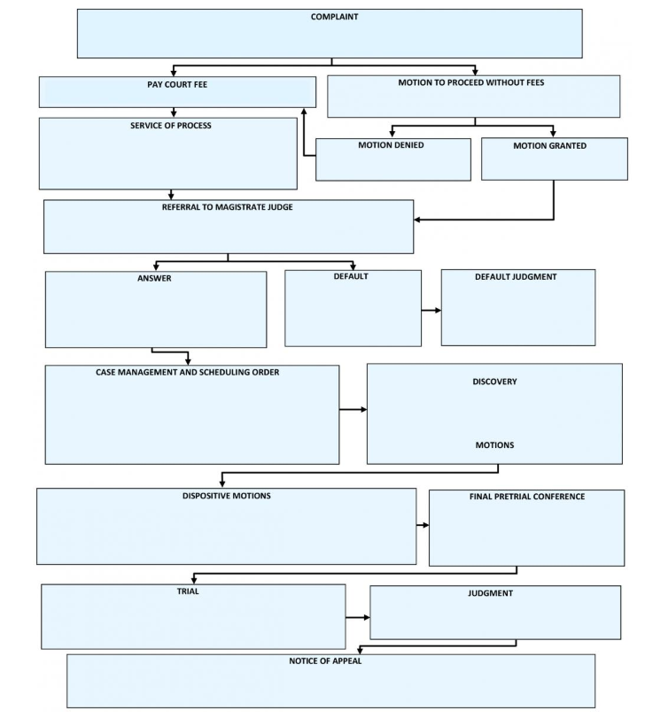

An Introduction to Pleadings
Text pp. 238-44

Slide 12
History of Pleading (text, pp 319-26, 329-35)
Common Law Pleading
  Borrowed from England
  Required that parties agree to put a single point in issue, of law or of fact, to determine their controversy
  The basis of their agreement was the "form of action, embodied in a writ
  Examples:
    Action of debt sur obligation ("Debt on an obligation")
    Action of debt sur contract ("Debt on a contract")
    Trespass vi et armis contra pacem regis ("Trespass with force and arms against the King's peace")
    Trespass sur la case ("Trespass on the case" or "action on the case")
      Conversion
      Nuisance
      Negligence
      Deceit
      Action on the case for words (Defamation, Slander)

Slide 13
Fact Pleading (Also Known as Code Pleading)
NY legislature adopted in 1848
Abolished the forms of action and “All the forms of pleading heretofore existing”
Provided that there would be “but one form of action, for the enforcement or protection of private rights and the redress or prevention of private wrongs, which shall be denominated a civil action”
Pleading standard:
  Each pleading shall contain a plain and concise statement of the material facts on which the pleader relies, but not of evidence and not of conclusions of law.

Slide 14
Difficulty in pleading
In practice, the difficulty in distinguishing between non-material and material, evidence, and legal conclusions led to complaints that, the system was “excruciatingly slow, expensive, and unworkable”
For example, how to allege negligence?
  Defendant negligently drove his car into me
  Plead the elements of negligence
    Defendant had a duty to drive with reasonable care
    Defendant breached that duty

Slide 15
Difficulties with Fact Pleading Led to FRCP
1938: “Notice” pleading
  Need not state facts of claim, just give notice of nature of claim
FRCP8(a) Claim for Relief. A pleading that states a claim for relief must contain:
  (1) a short and plain statement of the grounds for the court's jurisdiction, unless the court already has jurisdiction and the claim needs no new jurisdictional support;
  (2) a short and plain statement of the claim showing that the pleader is entitled to relief; and
  (3) a demand for the relief sought, which may include relief in the alternative or different types of relief.

Slide 16
Fact v. Notice
Fact: Each pleading shall contain a plain and concise statement of the material facts on which the pleader relies, but not of evidence and not of conclusions of law.
A pleading that states a claim for relief must contain … a short and plain statement of the claim showing that the pleader is entitled to relief
Hybrid: Connecticut Practice Book § 10-1. Fact Pleading
  Each pleading shall contain a plain and concise statement of the material facts on which the pleader relies, but not of the evidence by which they are to be proved …
  Must plead material facts, can’t plead evidence, can plead conclusions of law

Slide 17
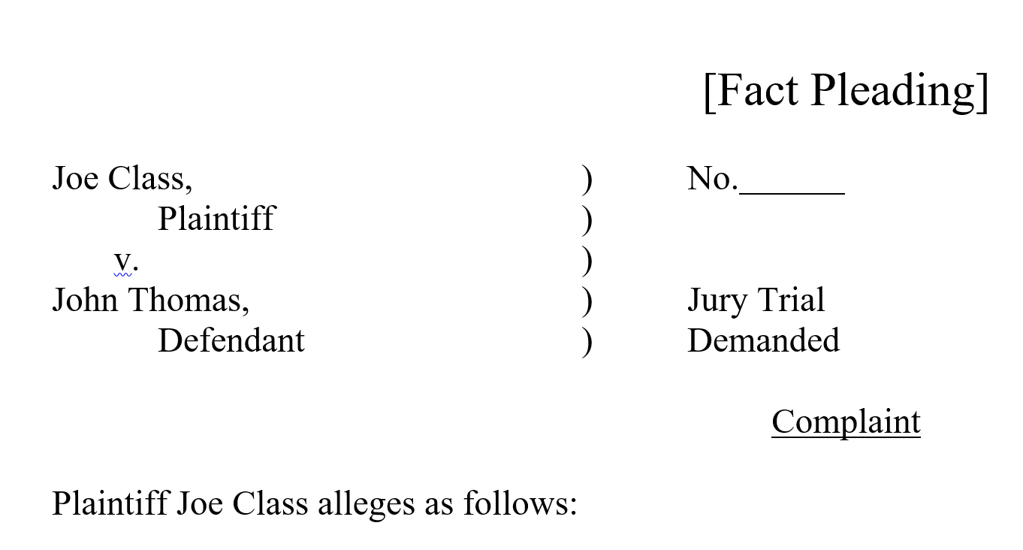
Our Prompt
One our “September 25, 2018 Online Session” forum, plead negligence in a way that conforms to the requirements of Field/fact pleading: contain a plain and concise statement of the material facts on which the pleader relies, but not of evidence and not of conclusions of law
I’ll get us started

Slide 18
The next few lines …
At all times relevant to the allegations of this complaint, Plaintiff Joe Class ("Class") and Defendant John Thomas ("Thomas") were citizens and residents of the State of Connecticut.
All acts alleged in this complaint occurred in the State of Connecticut.
On or about August 24, 2018, at approximately 8:30 am, Thomas was driving an automobile northbound on Bradley Street, in North Haven, Connecticut, toward the intersection of Bradley Street and Don Mar Court. At approximately that same time, Class was walking eastbound on the south side of Don Mar Court toward the same intersection.
At the time and place alleged in Paragraph 3 of this complaint, Class stepped into the intersection of Bradley Street and Don Mar Court.

Slide 19
OK, now you take over
Write the next few lines of the complaint
Please don’t write a short history of western civilization. Just a few lines
You need to plead the tort of negligence, without pleading evidence or conclusions of law
OK: post your few lines of pleading on our “October 2, 2018 Online Session Forum,” which is here: https://quinnipiac.blackboard.com/webapps/discussionboard/do/forum?action=list_threads&course_id=_64804_1&nav=discussion_board_entry&conf_id=_135782_1&forum_id=_196603_1

Slide 20
See you in Italy!

